Slide 1
bUTTONS
Taught by Yossef Ayman Zedan

Slide 2
Examples
Bootstrap includes several predefined button styles, each serving its own semantic purpose, with a few extras thrown in for more control.
<button type="button" class="btn btn-primary">Primary</button><button type="button" class="btn btn-secondary">Secondary</button> <button type="button" class="btn btn-success">Success</button> <button type="button" class="btn btn-danger">Danger</button> <button type="button" class="btn btn-warning">Warning</button> <button type="button" class="btn btn-info">Info</button> <button type="button" class="btn btn-light">Light</button> <button type="button" class="btn btn-dark">Dark</button> <button type="button" class="btn btn-link">Link</button>

Slide 3
Examples
Bootstrap includes several predefined button styles, each serving its own semantic purpose, with a few extras thrown in for more control.
<button type="button" class="btn btn-primary">Primary</button><button type="button" class="btn btn-secondary">Secondary</button> <button type="button" class="btn btn-success">Success</button> <button type="button" class="btn btn-danger">Danger</button> <button type="button" class="btn btn-warning">Warning</button> <button type="button" class="btn btn-info">Info</button> <button type="button" class="btn btn-light">Light</button> <button type="button" class="btn btn-dark">Dark</button> <button type="button" class="btn btn-link">Link</button>

Slide 4
Disable text wrapping
If you don’t want the button text to wrap, you can add the .text-nowrap class to the button. In Sass, you can set $btn-white-space: nowrap to disable text wrapping for each button.

Slide 5
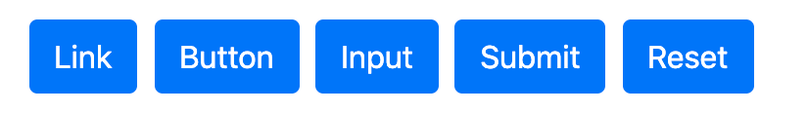
Button tags
The .btn classes are designed to be used with the <button> element. However, you can also use these classes on <a> or <input> elements (though some browsers may apply a slightly different rendering).
When using button classes on <a> elements that are used to trigger in-page functionality (like collapsing content), rather than linking to new pages or sections within the current page, these links should be given a role="button" to appropriately convey their purpose to assistive technologies such as screen readers.
<a class="btn btn-primary" href="#" role="button">Link</a> <button class="btn btn-primary" type="submit">Button</button> <input class="btn btn-primary" type="button" value="Input"> <input class="btn btn-primary" type="submit" value="Submit"> <input class="btn btn-primary" type="reset" value="Reset">

Slide 6
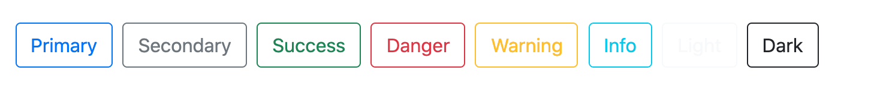
Outline buttons
In need of a button, but not the hefty background colors they bring? Replace the default modifier classes with the .btn-outline-* ones to remove all background images and colors on any button.
<button type="button" class="btn btn-outline-primary">Primary</button> <button type="button" class="btn btn-outline-secondary">Secondary</button> <button type="button" class="btn btn-outline-success">Success</button> <button type="button" class="btn btn-outline-danger">Danger</button> <button type="button" class="btn btn-outline-warning">Warning</button> <button type="button" class="btn btn-outline-info">Info</button> <button type="button" class="btn btn-outline-light">Light</button> <button type="button" class="btn btn-outline-dark">Dark</button>

Slide 7
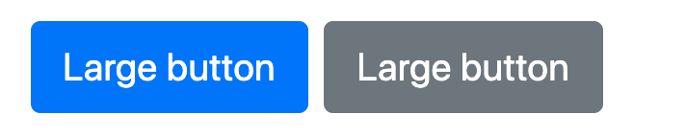
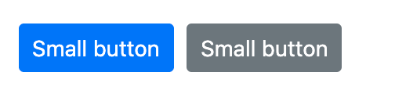
Sizes
Fancy larger or smaller buttons? Add .btn-lg or .btn-sm for additional sizes.
<button type="button" class="btn btn-primary btn-lg">Large button</button>
<button type="button" class="btn btn-secondary btn-lg">Large button</button>
<button type="button" class="btn btn-primary btn-sm">Small button</button>
<button type="button" class="btn btn-secondary btn-sm">Small button</button>

Slide 8
Disabled state
Make buttons look inactive by adding the disabled boolean attribute to any <button> element. Disabled buttons have pointer-events: none applied to, preventing hover and active states from triggering.
<button type="button" class="btn btn-lg btn-primary" disabled>Primary button</button> <button type="button" class="btn btn-secondary btn-lg" disabled>Button</button> Disabled buttons using the <a> element behave a bit different:
<a>s don’t support the disabled attribute, so you must add the .disabled class to make it visually appear disabled.
Some future-friendly styles are included to disable all pointer-events on anchor buttons.
Disabled buttons should include the aria-disabled="true" attribute to indicate the state of the element to assistive technologies.
<a href="#" class="btn btn-primary btn-lg disabled" role="button" >Primary link</a>
<a href="#" class="btn btn-secondary btn-lg disabled" role="button" >Link</a>

Slide 9
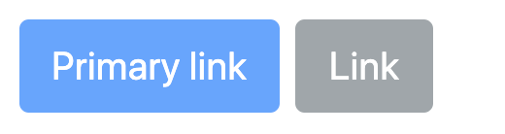
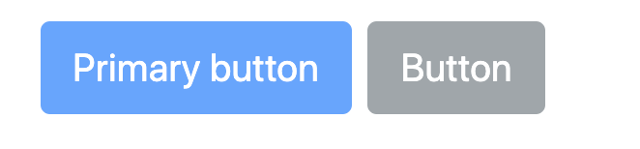
Disabled state

Slide 10
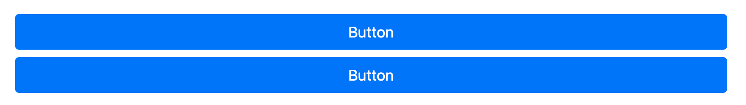
Block buttons
Create responsive stacks of full-width, “block buttons” like those in Bootstrap 4 with a mix of our display and gap utilities. By using utilities instead of button specific classes, we have much greater control over spacing, alignment, and responsive behavior
<div class="d-grid gap-2">
<button class="btn btn-primary" type="button">Button</button>
<button class="btn btn-primary" type="button">Button</button>
</div>

Slide 11
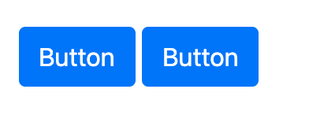
Block buttons
Here we create a responsive variation, starting with vertically stacked buttons until the md breakpoint, where .d-md-block replaces the .d-grid class, thus nullifying the gap-2 utility. Resize your browser to see them change.
<div class="d-grid gap-2 d-md-block">
<button class="btn btn-primary" type="button">Button</button>
<button class="btn btn-primary" type="button">Button</button>
</div>

Slide 12

Block buttons
You can adjust the width of your block buttons with grid column width classes. For example, for a half-width “block button”, use .col-6. Center it horizontally with .mx-auto, too.

Slide 13
Block buttons
Additional utilities can be used to adjust the alignment of buttons when horizontal. Here we’ve taken our previous responsive example and added some flex utilities and a margin utility on the button to right align the buttons when they’re no longer stacked.
<div class="d-grid gap-2 d-md-flex justify-content-md-end">
<button class="btn btn-primary me-md-2" type="button">Button</button>
<button class="btn btn-primary" type="button">Button</button>
</div>

Slide 14
Toggle states
Add data-bs-toggle="button" to toggle a button’s active state. If you’re pre-toggling a button, you must manually add the .active class and aria-pressed="true" to ensure that it is conveyed appropriately to assistive technologies.
<button type="button" class="btn btn-primary" data-bs-toggle="button">Toggle button</button>
<button type="button" class="btn btn-primary active" data-bs-toggle="button" aria-pressed="true">Active toggle button</button>
<button type="button" class="btn btn-primary" disabled data-bs-toggle="button"> Disabled toggle button</button>

Slide 15
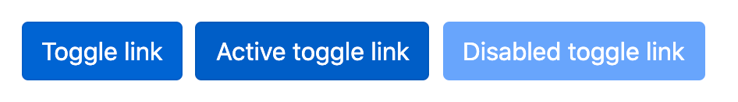
Toggle states <a> tag
<a href="#" class="btn btn-primary" role="button" data-bs-toggle="button">Toggle link</a>
<a href="#" class="btn btn-primary active" role="button" data-bs-toggle="button" aria-pressed="true">Active toggle link</a>
<a href="#" class="btn btn-primary disabled role="button" data-bs-toggle="button">Disabled toggle link</a>

